Slide 1
The ChapR Presentation

Slide 2
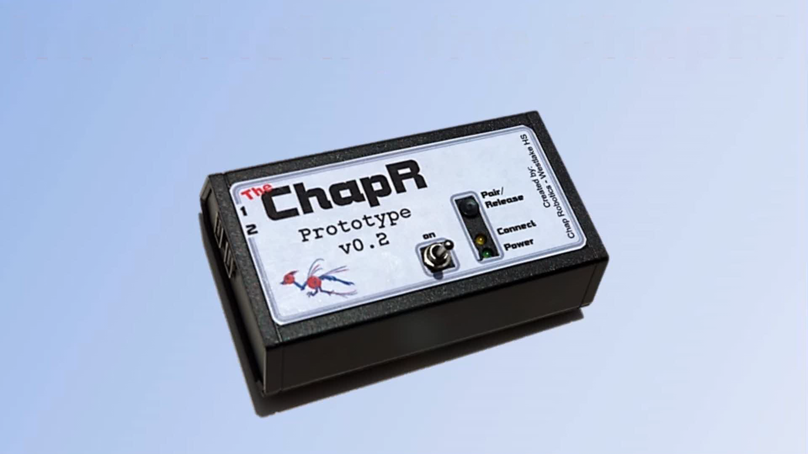

Slide 3
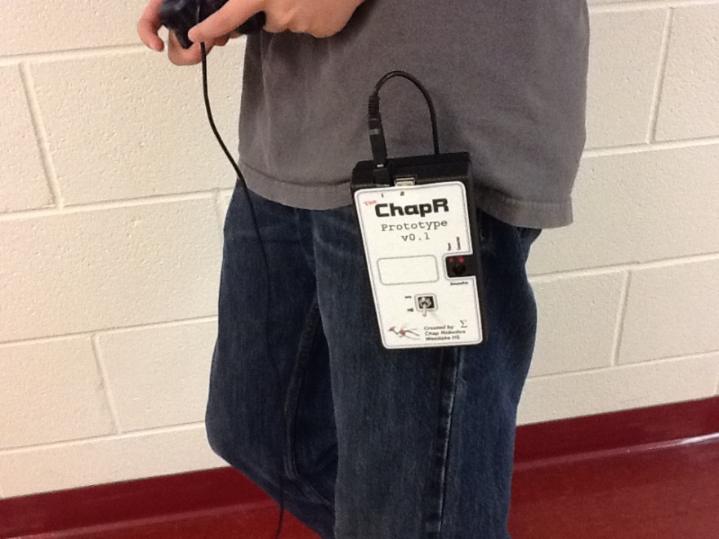
What is the ChapR?
A remote for translating USB “joystick” input to BT for controlling robots
A way around RobotC/LabView/NXT-G to quickly run programs

Slide 4
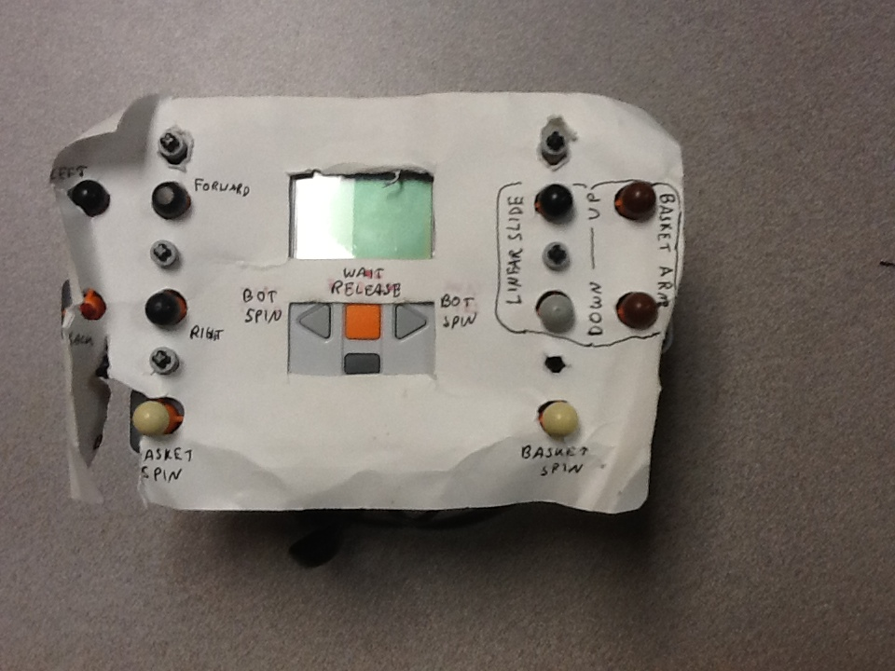

Slide 5
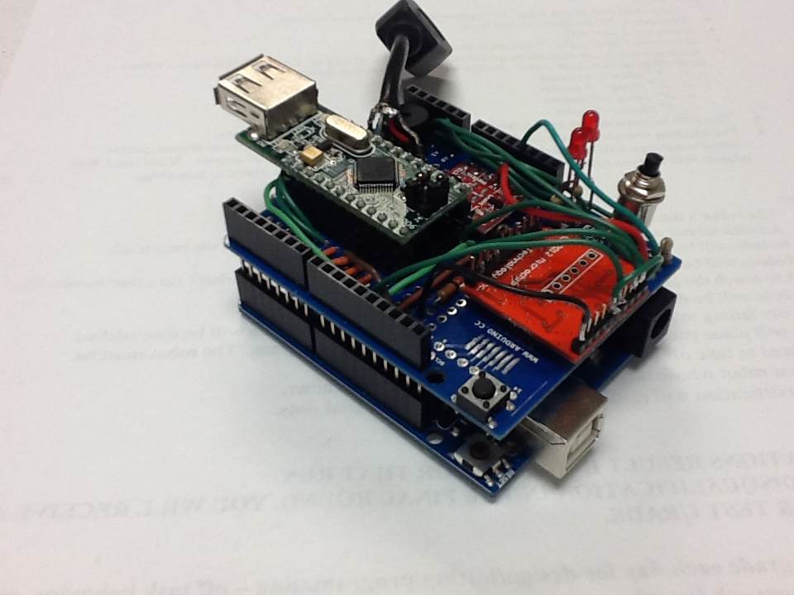
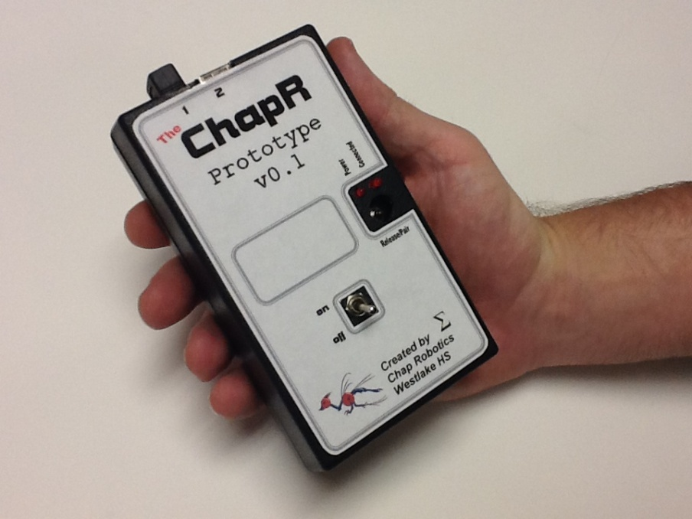

Slide 6
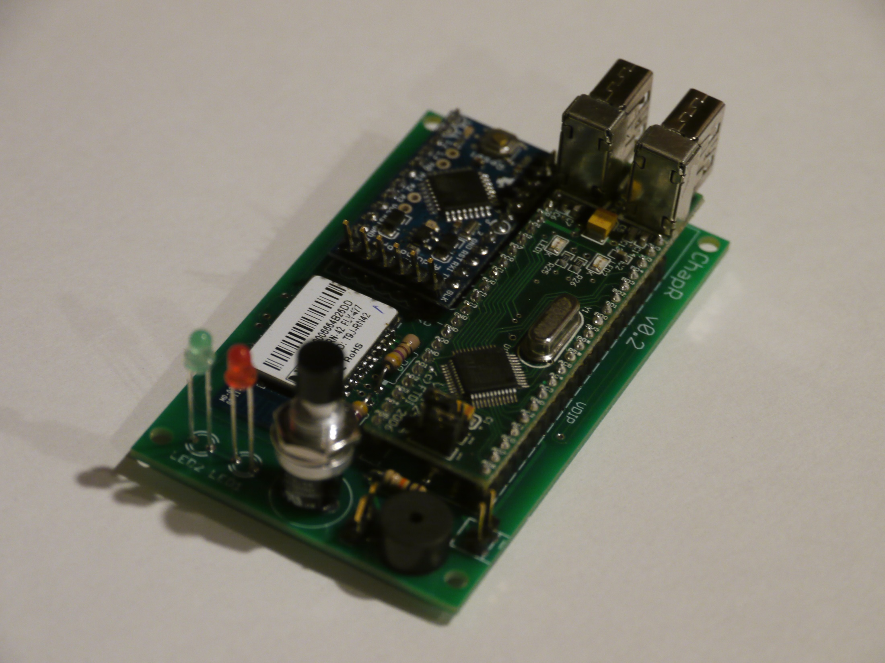
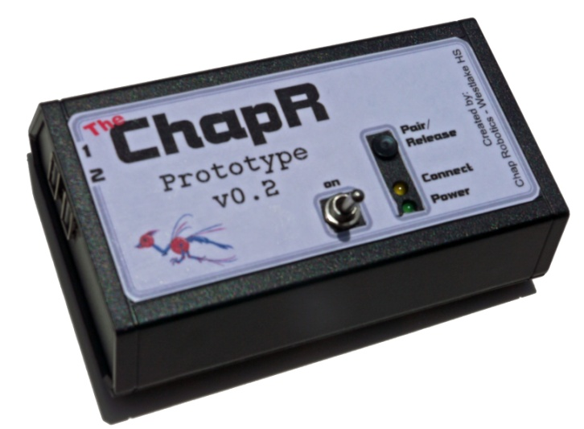

Slide 7
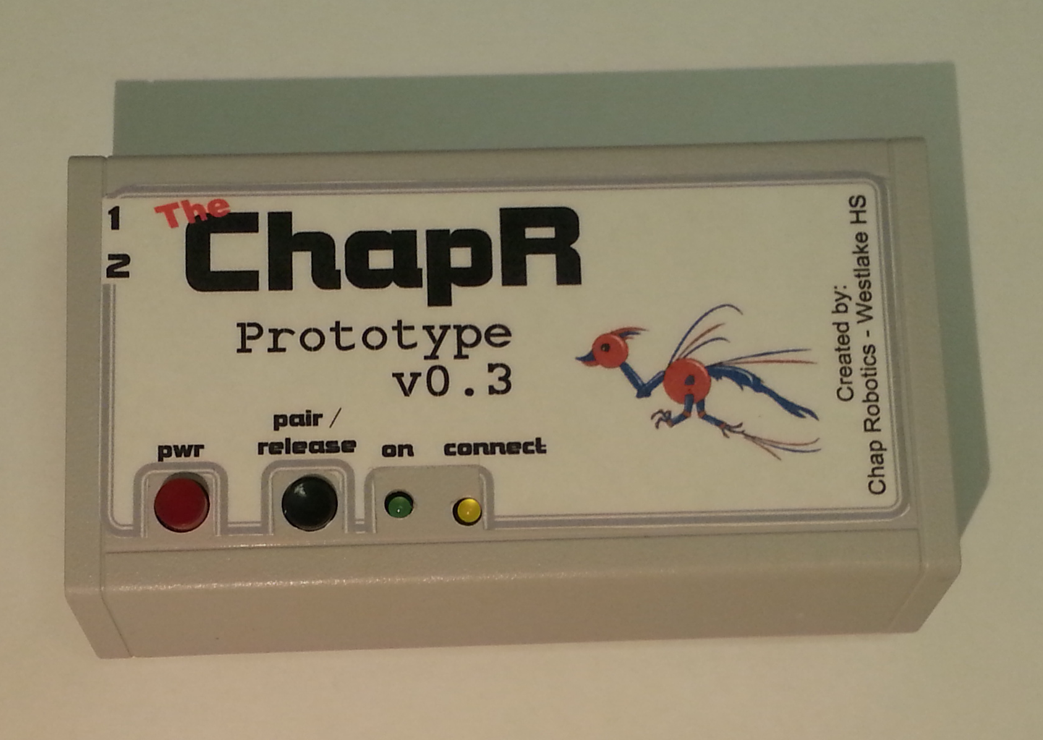

Slide 8
DEMO

Slide 9
ChapR Benefits: FTC Teams
Convenient way of testing
Eliminates BT difficulties
Provides easy competition-style driving
Allows teams without access to multiple PCs to test effectively
We have received great feedback so far, both from teams at Worlds and through our website!

Slide 10
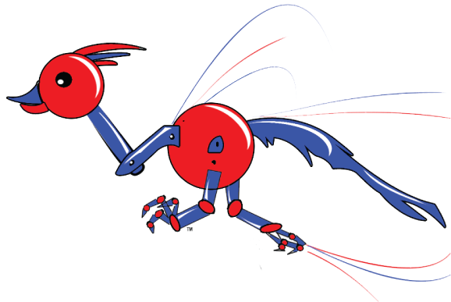
ChapR Benefits: Westlake
Experience in product design, development and delivery (marketing, sales, manufacturing etc.)
Chance to give back to the FTC community and spread STEM
Every 4th ChapR is given to a team in need for free
Service hours and experience for Westlake students making ChapRs
Spreading the name of Westlake Robotics
Patent for WESTA (hopefully)
Something to talk about for awards

Slide 11
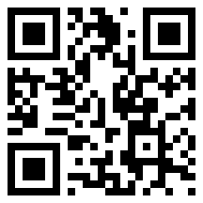
Plan
Buy parts for 10 ChapRs (20 boards have been ordered)
Set up 3 soldering stations and train 6 people to solder boards (3 of which would be the ChapR team)
Get back in touch with the people who initially showed interest
Send a ChapR to Irad Allen at VHS and David Calkins at Lego Education
Keep in touch with the beta testers and fix bugs if necessary
Give 4 ChapRs to Westlake

Slide 12
What do we need?
$450 total for 3 soldering stations
$1125 total for 15 ChapRs at cost
5 to reimburse Coach Eric
10 to build new ChapRs
$750 will be returned after the sale of the ChapRs (minus the 4 that go to Westlake)
A 501(c)3 nonprofit organization to accept funds and legally avoid taxes

